Slide 1
Coach Notes
In this lesson debugging messages will appear frequently in the shell, make sure students know to ignore these since they look like errors.
If the class finishes early, feel free to let them try out the audio visualizer program, you can go over it if you feel you have enough time to but you will likely not have enough time to go over it.

Slide 2
Machine Learning with Raspberry Pi
Lesson 4: Microphone
AI Code Academy

Slide 3
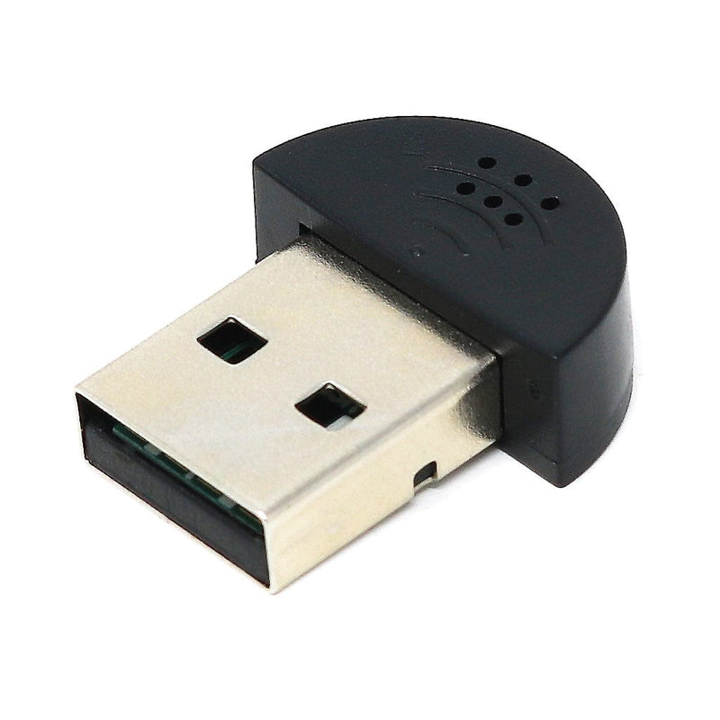
Materials Needed
For this lesson, we’ll need the following materials:
Raspberry Pi with SSH and VNC connection
USB Microphone
USB Speaker

Slide 4
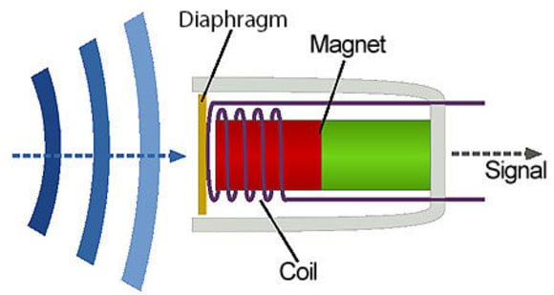
Microphones
A microphone is a transducer which converts sound into an electrical current.
Sound waves vibrate the diaphragm of the microphone which will move a coil or magnet to produce the signal.
Microphone signals are weak and need an amplifier if we want to play it back.

Slide 5
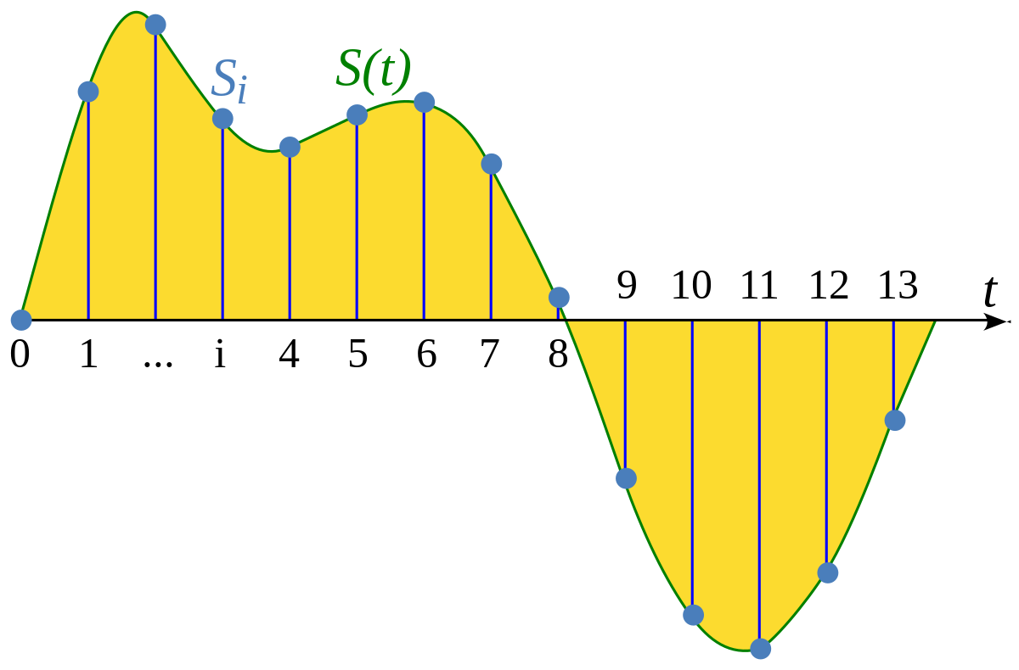
Sampling
For us to use the audio signal our microphone creates, we must convert it to a digital signal.
To create a digital signal, we must sample it and save a portion of the signal every so often.
If the signal is sampled enough, it can be recreated and the there will be a negligible difference between the two signals.
How often we sample the signal is known as the sampling rate.

Slide 6
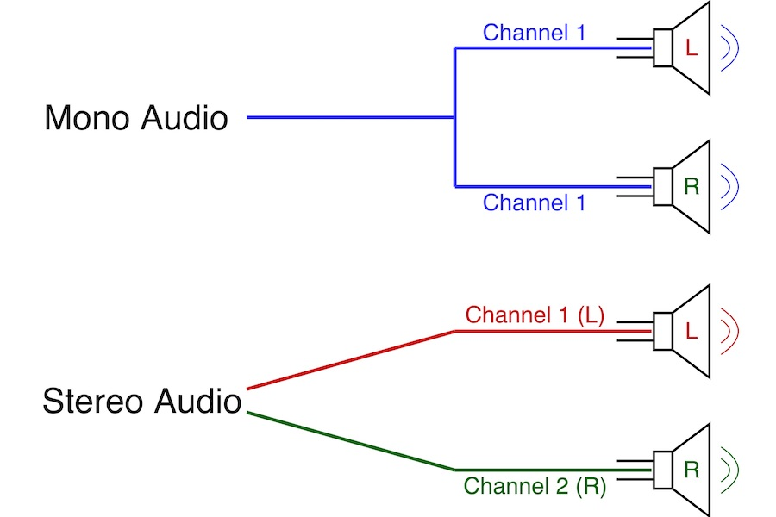
Audio Channels
Audio channels are paths audio can take from one point to another. Some devices accept one or more audio channels.
In the context of headphones:
Mono audio uses one channel for both the left and right speaker so both channels will have the same audio.
Stereo audio has two audio channels so each speaker can have its own audio. This is how some sounds can be played in only one ear.

Slide 7

Finding Our Microphone
When we program with the microphone, we need to first identify its device number.
In the terminal, enter the command arecord –l and it will show all the capture (input) devices connected to the Pi. Your output may or may not be different.
This microphone has the device number 2 and is the USB PnP Sound Device.

Slide 8
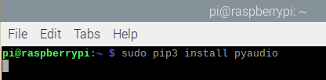
Module Install
Please install the following module using the pip commands.
Pyaudio:
This module will help us complete our lesson today.
Notes:
If import errors arise, try installing Libportaudio: sudo apt-get install libportaudio0 libportaudio2 libportaudiocpp0 portaudio19-dev

Slide 9
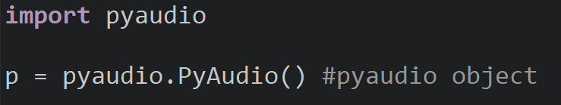
Finding Device Index: Pyaudio
Pyaudio is one of the many modules that can use our microphone to record audio and play sounds.
To use pyaudio, we create an instance of the PyAudio object and save it into a variable p.
Pyaudio contains many functions that we can use to help us identify our microphone’s device index.

Slide 10
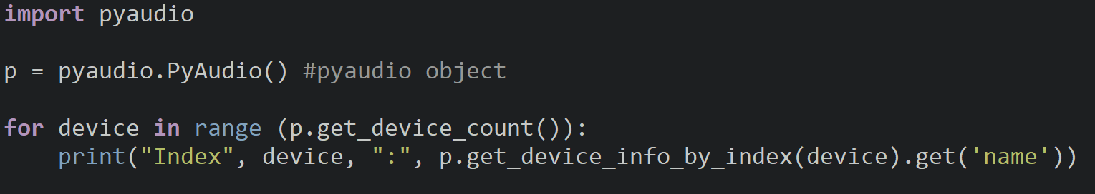
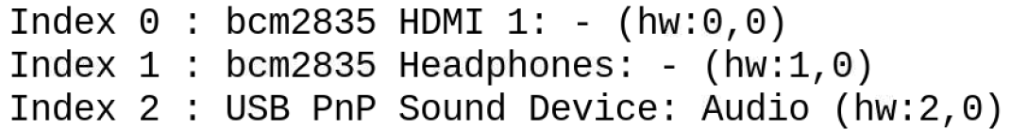
Finding Device Index: Pyaudio
get_device_count will return the number of devices connected to the Pi and
get_device_info_by_index will return information about the device to us.
The get function returns the information specified in the parameter.
Notes:
Students will have other outputs when they run this, just tell them to ignore them. As long as they can identify the microphone, that is all that matters.

Slide 11
Recording Audio
We will now use the Pyaudio module to record audio from our microphone and save it into a wav file.
We will make use of buffers which will hold our data temporarily while we wait to transfer it to another location.
For example, we will store parts of the audio file in a buffer before we read or write to the file.

Slide 12
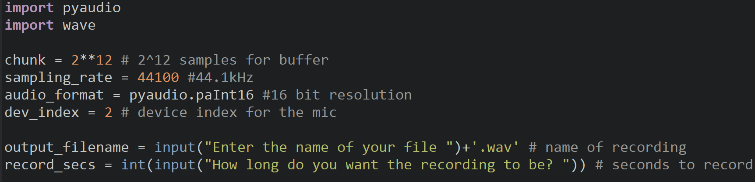
Recording Audio
Import the pyaudio and wave module and create variable to store basic information about the recording. For our recording, we will save 2¹² samples in the buffer, use a 44100 Hz sampling rate, 16-bit resolution, and the index for our microphone.
The user will input a file name and how long to record.

Slide 13
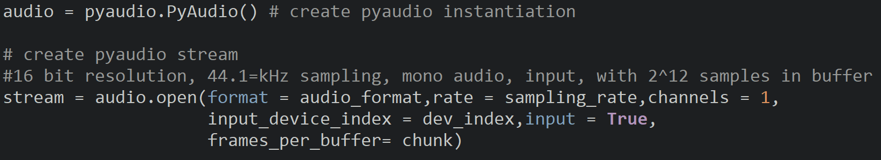
Creating An Audio Stream
Create an audio stream with the open method and configure it for our sampling rate, format, the buffer size, and input index.
We will use one audio channel (record in mono) and configure the stream to be an input.

Slide 14
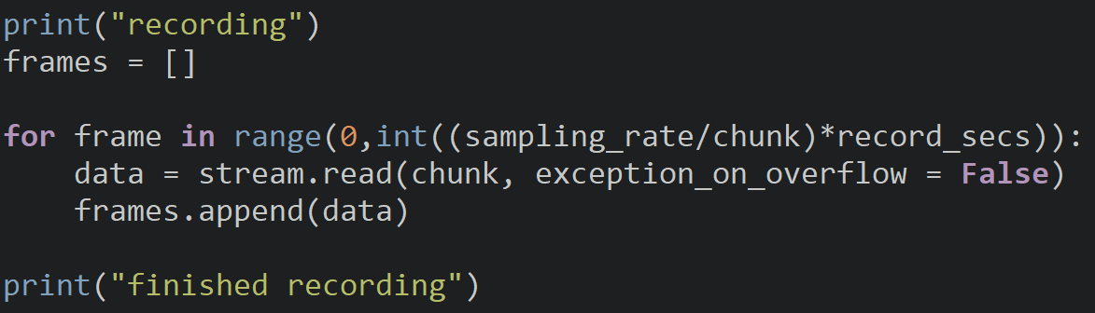
Reading The Stream
When we read from our audio stream, the data from the buffer is read, so we run the for loop until there is no more data in the buffer.
To read from the audio stream, we use the read method and tell it how many chunks (samples) to read and save it into a variable data which is appended to a frames list.
exception_on_overflow is set to False, so our program doesn’t crash if our buffer becomes full.

Slide 15
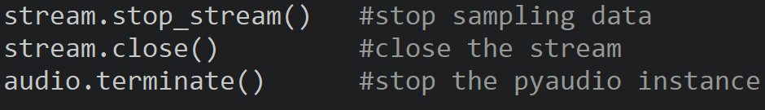
Closing The Stream
When we are done with the audio stream, stop and then close it.
Finally, close the pyaudio instance once we are done working with it.

Slide 16
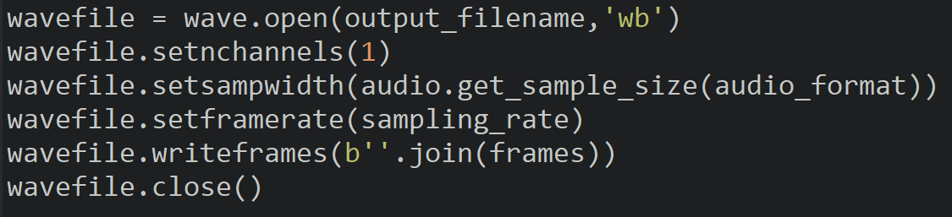
Saving The File
Create a wave file and configure it to make our recording settings.
Write the microphone data to the file and close it.

Slide 17

Try It
Inside the folder where you wrote your code you should see a wav file.
Open the file and see if you can hear your voice.

Slide 18
Playing Audio
We will now use the Pyaudio module to play audio from a wav file.
The process is similar to recording audio just with a few minor changes.
We can either play the audio file we just created or if you have your own file, feel free to use it. (Just make sure it is appropriate)
Make a copy of your recording code and we will adjust it to play audio.

Slide 19
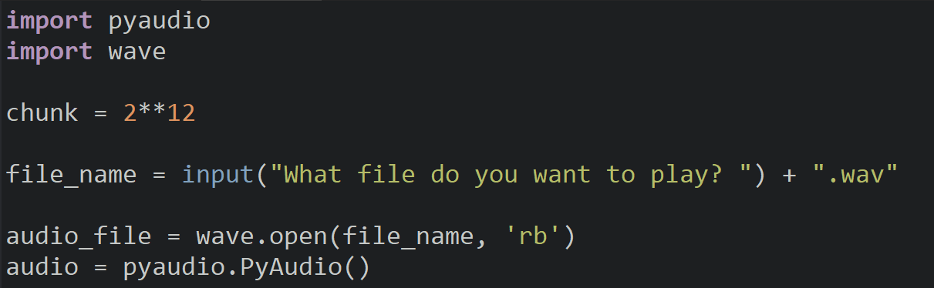
Imports & Load File
The setup is similar with the difference that a file is opened and saved into a wave object.

Slide 20
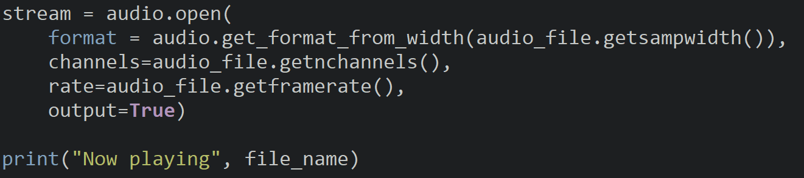
Audio Stream
To create an audio stream to play audio, you will set all the audio proprieties like the channels, sampling rate, and resolution, but we will use the properties from the wave file directly.
Make sure to set output to True so the stream will play out audio.

Slide 21
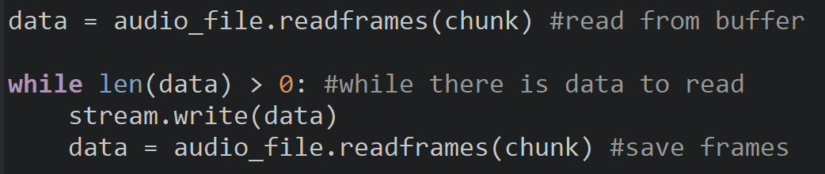
Writing Audio To The Stream
To read from the wav file, we call readframes and pass how many samples (frames) to read and store into the data variable.
A while loop will execute until the data returned has a length of 0 signifying the end of the file.
To play the audio, we write the data to the audio stream and read the next set of frames.

Slide 22
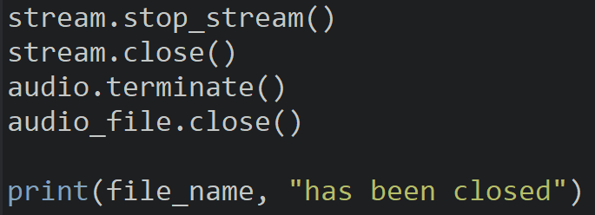
Writing Audio To The Stream
Before the program ends, we stop the audio stream and properly close all the files we opened.

Slide 23
Discussion
What projects and applications can you see using the microphone in?
Could you create a program that would let the user record audio and play music when certain buttons are pressed?

Slide 24
Power off
As usual, shut down your pi properly before disconnecting power.

